Slide 1
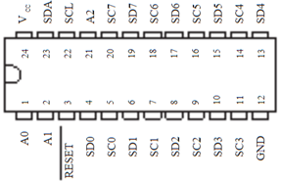
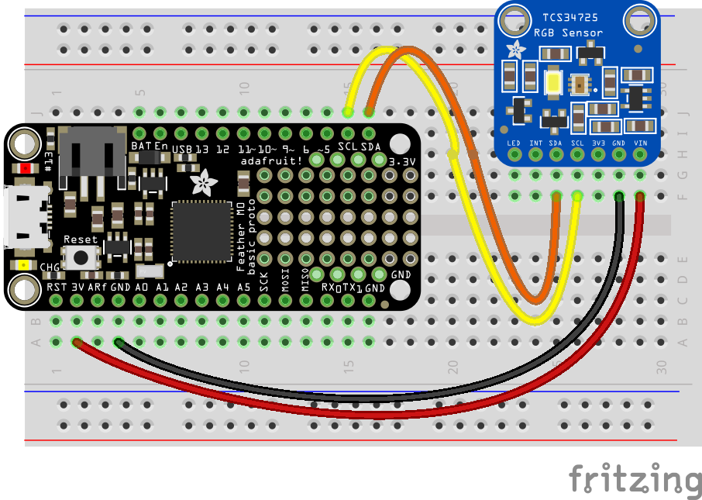
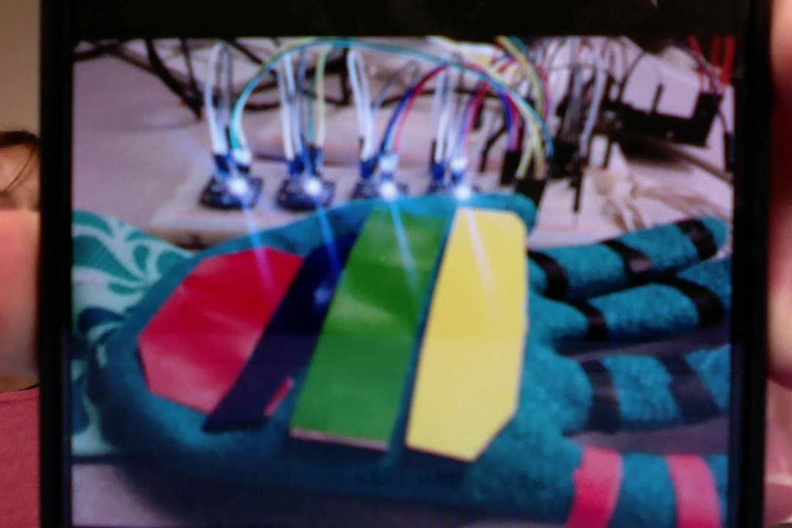
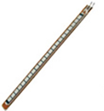
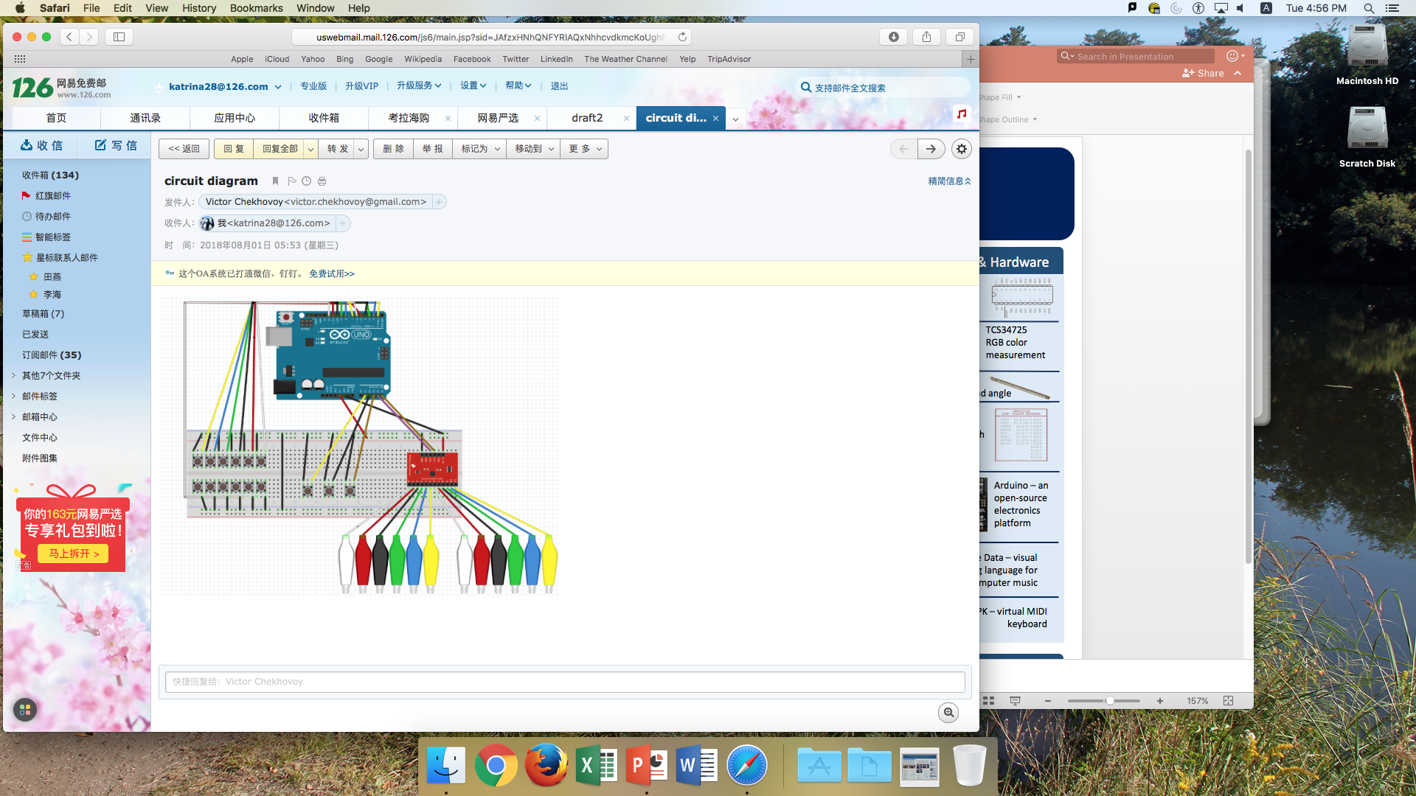
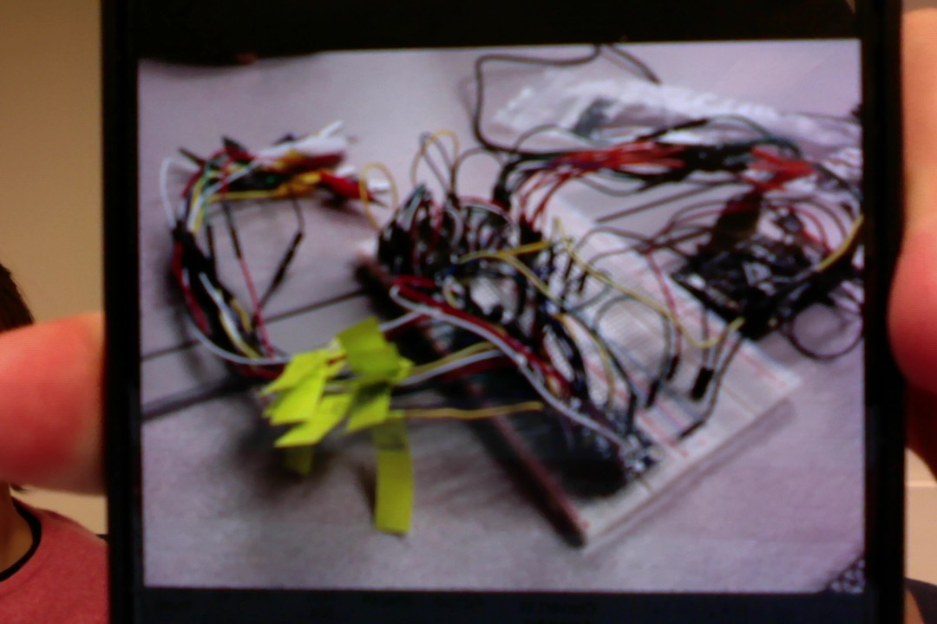
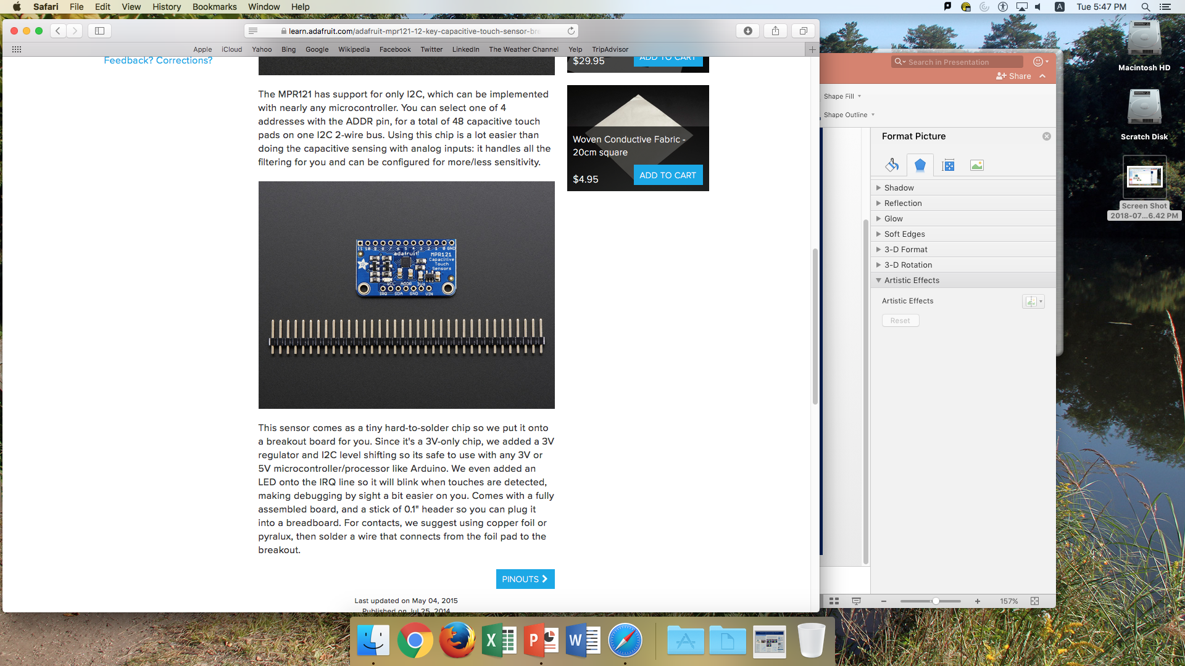
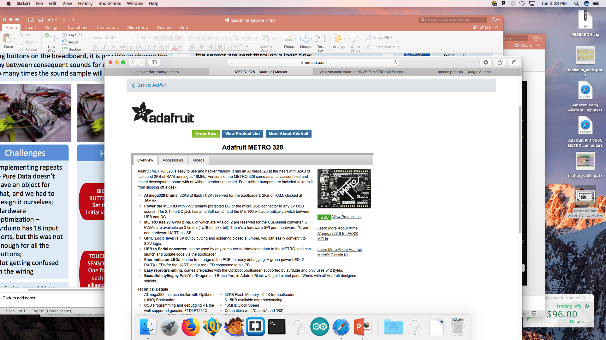
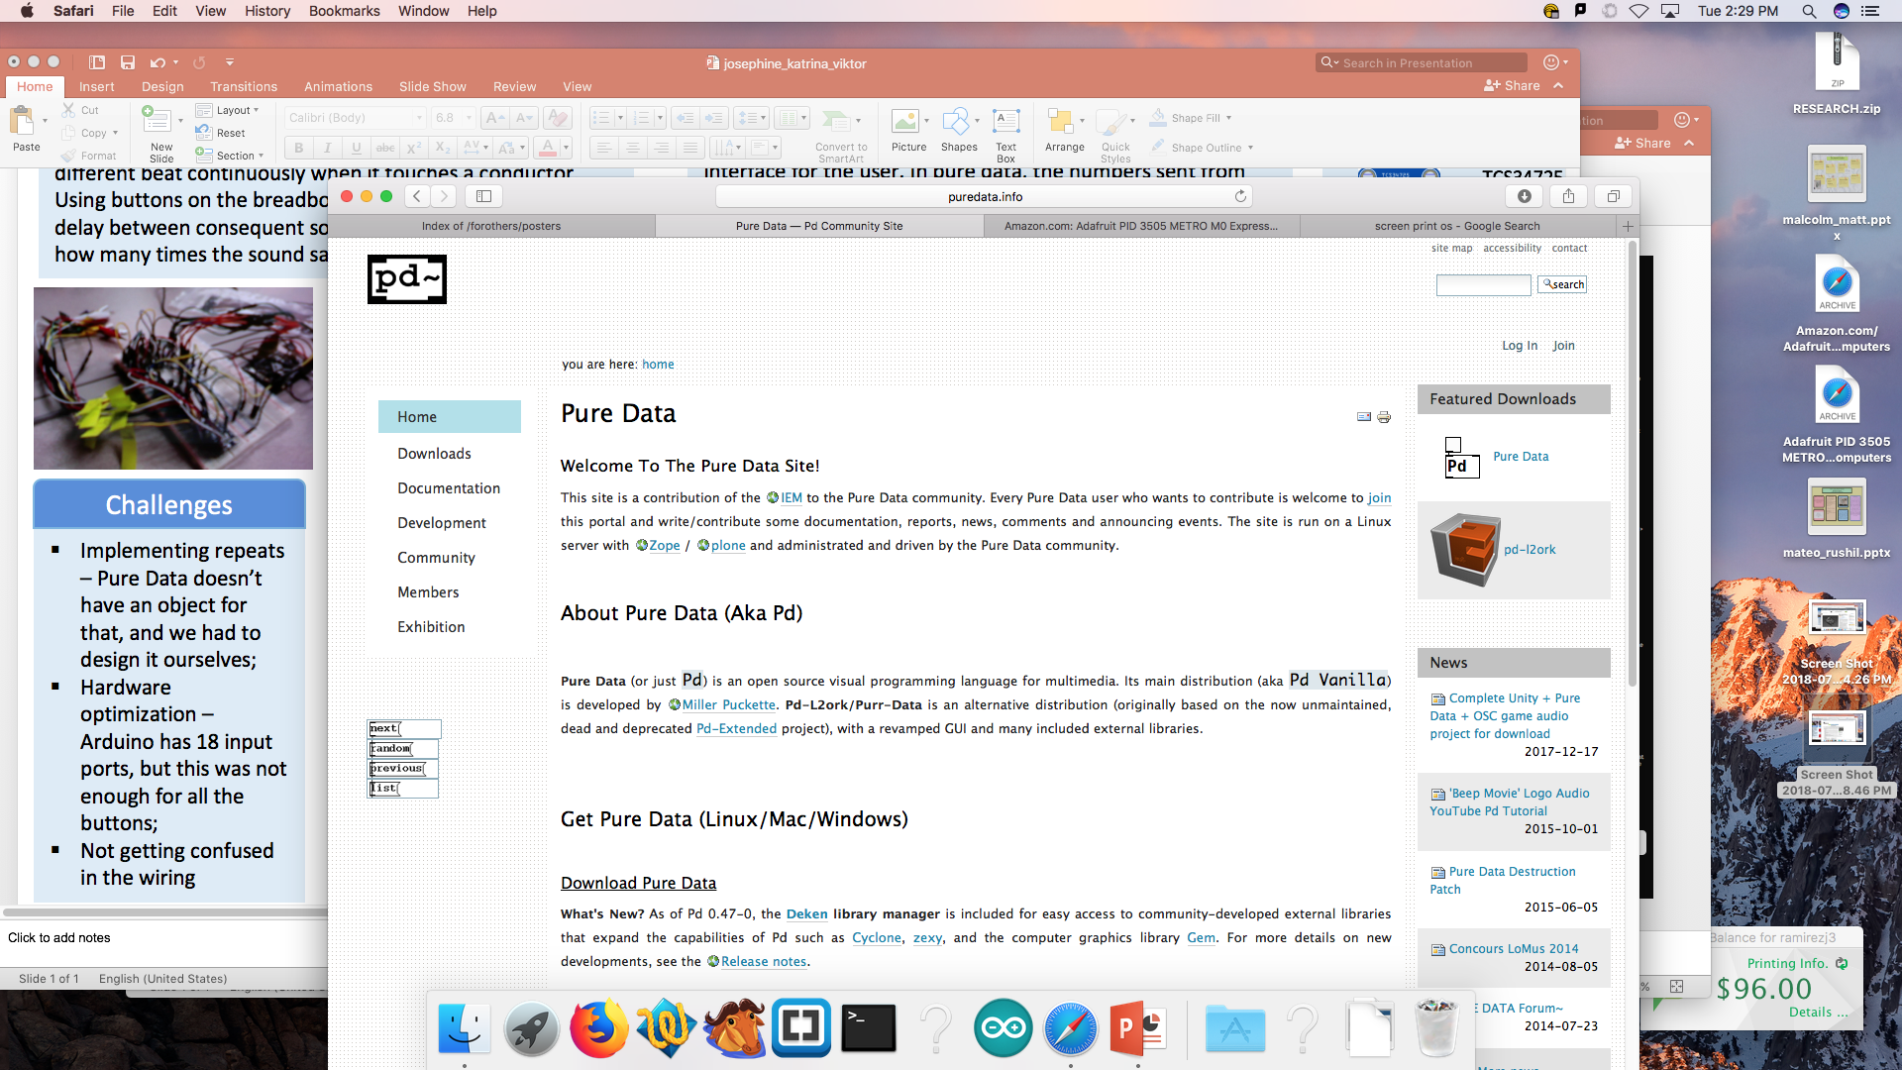
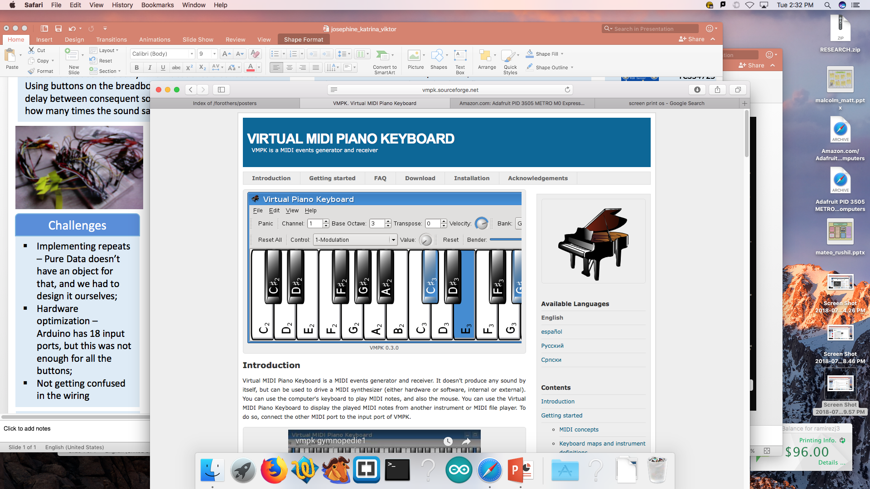
Designing a Digital, Interactive Music Experience
Katrina Li, Viktor Chekovoi, Josephine Ramirez
Digital Drum
Digital Violin
Software & Hardware
The goal of this project is to create an instrument that would allow a user to create their own, unique rhythms. This instrument has 12 alligator clips; each of them will play a different beat continuously when it touches a conductor. Using buttons on the breadboard, it is possible to change the delay between consequent sounds for each clip, as well as how many times the sound sample will play until the delay.
Designed to simulate a violin, the digital violin uses both flex and color sensors to optimize violin like positions and sounds. A glove is used to mount the sensors, and create a wearable interface for the user. In pure data, the numbers sent from the sensor are sent through a logic flow.
TCA9548A
multiplexer
TCS34725
RGB color measurement
Flex sensor
Measures bend angle
Adafruit MPR121 touch sensor
Arduino – an open-source electronics platform
Challenges
How it Works
How it Works
Implementing repeats – Pure Data doesn’t have an object for that, and we had to design it ourselves;
Hardware optimization – to arrange sufficient button ports for 18 buttons
Not getting confused in the wiring
SMALL BUTTONS
Change the delay/number of repeats
1 Send the color sensor value for string name (R,G,B,Y = G,D,A,E)
2 Which color sensor is being used
Pure Data – visual programming language
for creating computer music
BIG BUTTONS
Set the initial values
Challenges
VMPK – virtual MIDI keyboard
Arduino
Mounting hardware to the user interface.
Controlling 4 color sensors
Arduino
3 Flex Sensor angle = 0 or 1 for on or off
References
TOUCH SENSOR
One for each alligator clip
Professor: Chris Johnson
https://twodee.org/blog/
Research Assistant: Sam Wiseman
https://www.adafruit.com
https://forum.arduino.cc
https://www.instructables.com/id/ANDI-Random-Rhythm-Generator-Electronics/
Future Design Ideas: Add pre-made background music;
Improve user interface, make the controls more intuitive;
Pure Data
Future Design Ideas: Include the possibility to shift for a more realistic experience.
Pure Data

